Slide 1
Launching a Student Recruitment and Retention Campaign
Presented by Monica Armenta
Executive Director of Communications Albuquerque Public Schools
July 14, 2022

Slide 2
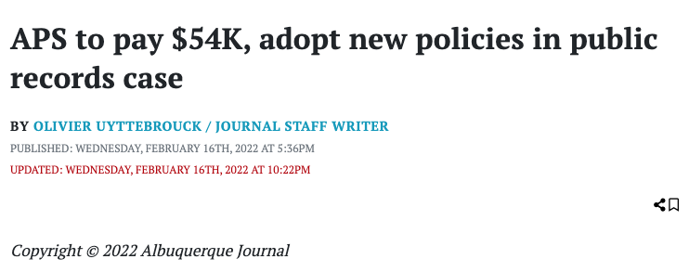
Our Challenge
Negative Headlines
Skeleton Staff
Changing Public Perception
01
03
Nothing new. Won’t go away, but can be managed and minimized.
02
Staff of 3.5 for 73,346 students, 11,000 employees, 141 schools, 89 departments
Even though we push positive stories daily, we struggle to get our message heard.
Notes:
While we have always been a small staff (the district prioritizes money for schools), APS Communications has lost a couple of positions over the past few years.

Slide 3
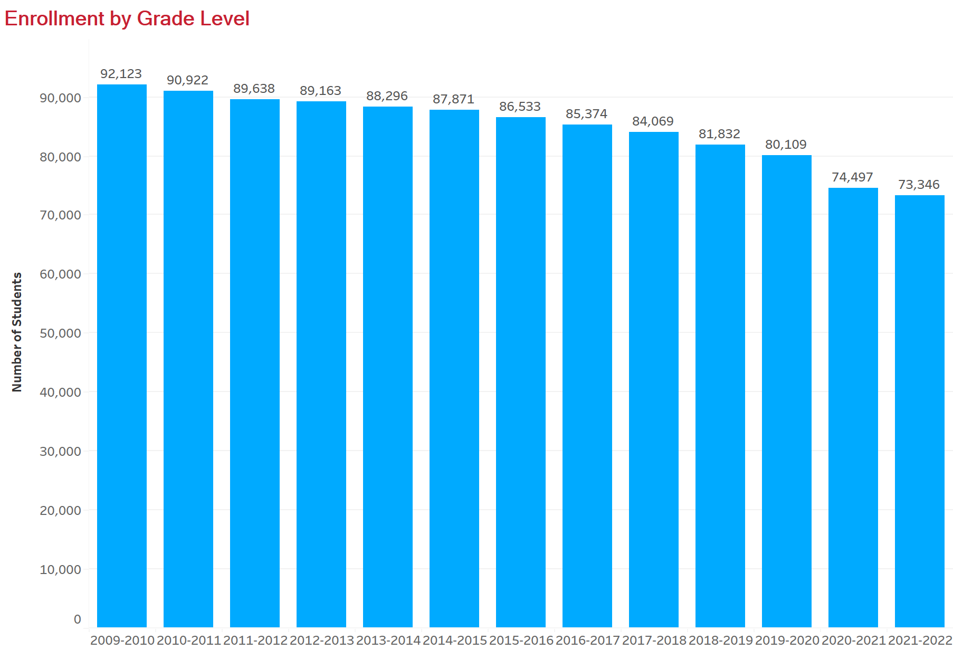
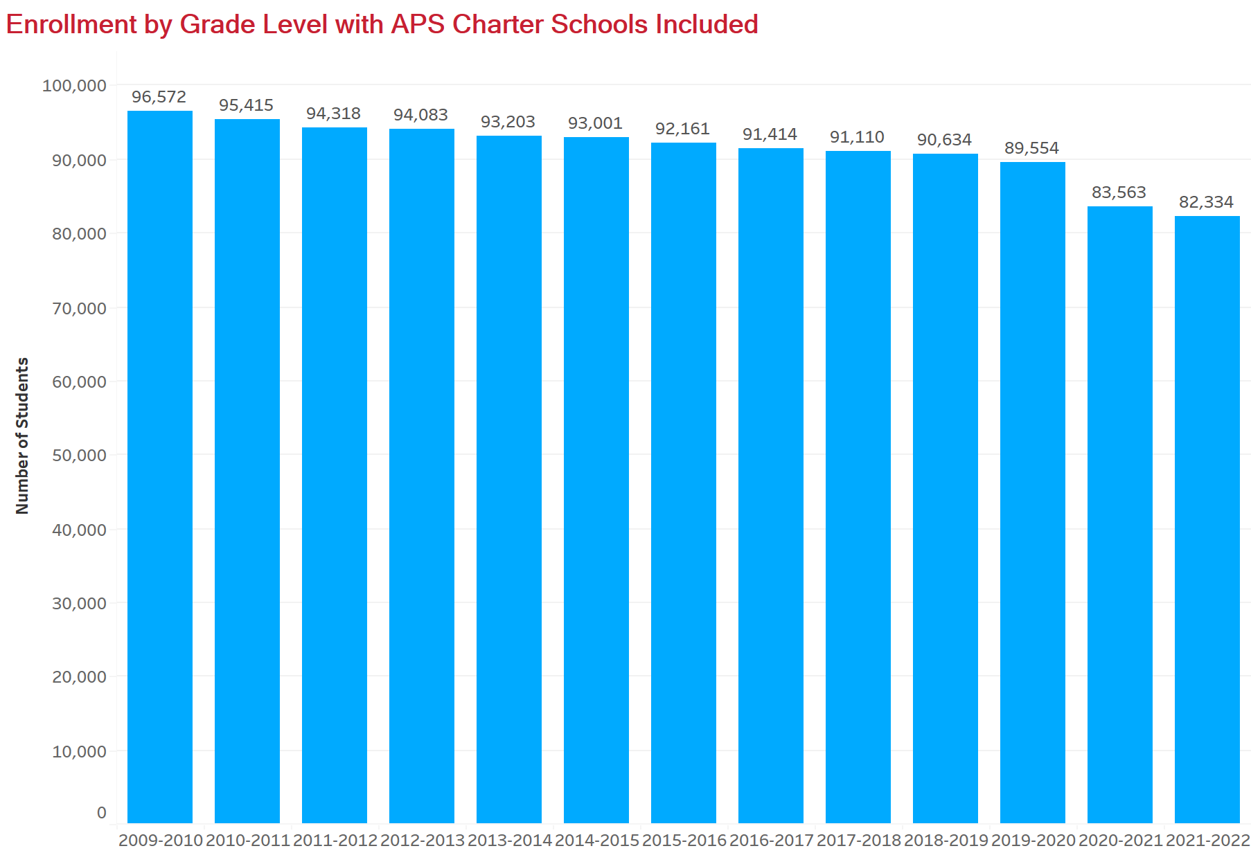
Declining Enrollment
Notes:
Drop of enrollment by nearly 19,000 students in 13 years. About 9,000 students accounted for in APS charter schools. Also believe birth rate and people moving out of the area account for decline.

Slide 4
2030

Slide 5
Game Plan
Phase One
Soft Launch
APS Wall Calendar
The calendar is the ONLY printed APS resource distributed to every school for families, employees, local businesses and government agencies. The focus of the 2021-2022 calendar was student and family choice.
Notes:
we’ve had a partnership with ABQ the Magazine for over a decade now. In years past the magazine has picked up the cost of printing 80-thousand plus APS wall calendars. The magazine took a financial COVID hit this year and was unable to provide that monetary support but is providing 4 complimentary ads in the magazine in the months ahead. As always, we are grateful to Albuquerque the Magazine.Cost $22K))
The APS wall calendar is the ONLY printed APS resource distributed to every school, family, staff, local businesses and government agencies.
We were unable to produce a calendar last year because of the uncertainty COVID created. It was heartwarming and affirming to receive so many calls requesting the calendar.
The distribution of the 2021-2022 enrollment-themed calendar was the soft launch of the Recruit and Retain Campaign. Each month is dedicated to an APS program complete with a QR code that takes the reader to a page with more information about the featured program.

Slide 6
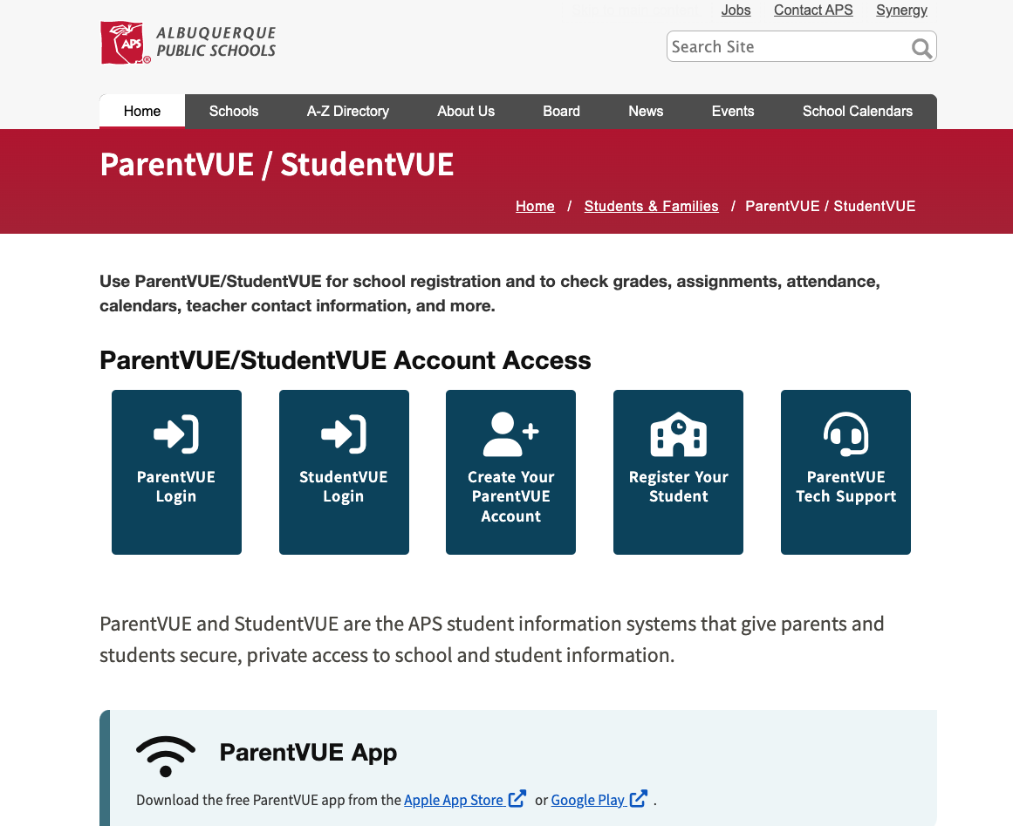
Game Plan
Phase One
Online Registration Landing Page
Notes:
(We also partnered with our Student Information System to promote online registration.

Slide 7
Game Plan
Phase One
Electronic Billboard Messaging
Notes:
Superintendent Elder recorded welcome messages that ran on KANW and we saturated our marketing venues with APS stories. We used billboards, internal and external newsletters, our district and individual school websites, messages from the superintendent, and the media to help get the word out. )

Slide 8
PENNIES FROM HEAVEN
Federal Funds Plug Urgent Needs
$194,636 in ESSR 2 and CRRSA funds was allocated to APS Communications to recruit staff and students and keep them enrolled in our schools.

Slide 9
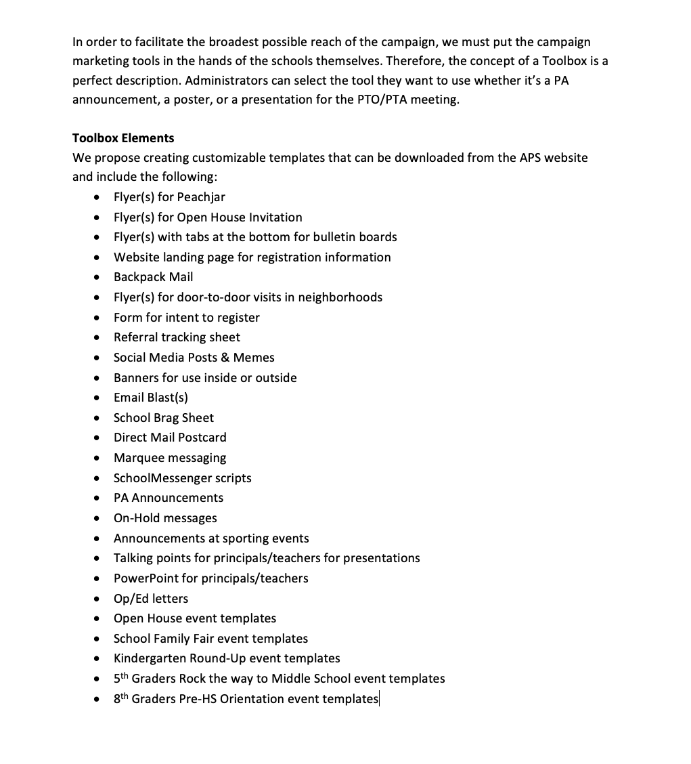
Our Plan
Phase Two
Marketing Agency Cost: $90,936

Slide 10
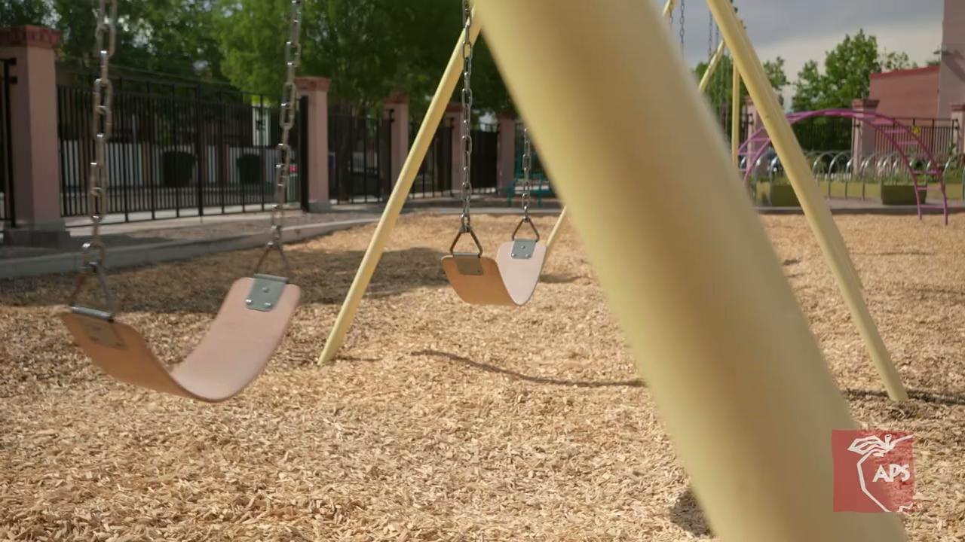
Our Plan
Phase Two
Two pronged approach:
External Marketing
Targeted groups, billboards, digital advertising, and paid social media
Notes:
(targeted groups, billboards, digital advertising, paid social media - focus was to illustrate what APS offers that might not be found, or be limited in private/charter/parochia/online/homeschool

Slide 11
Our Plan
Phase Two
Two pronged approach:
Internal Marketing
School administrators need tools they can implement at the local school level
Notes:
The second, and perhaps most important marketing strategy is internal. School administrators needed tools they could implement at the local school level and customize to their specific needs.

Slide 12
INFLUENCERS
Notes:
It is widely known and accepted that you can’t beat word-of-mouth marketing. People love their individual schools, principals, teachers, and friends. Individuals with school-ties are trusted and carry great influence.

Slide 13
Turnkey Principal Toolkit
It is widely known and accepted that you can’t beat word-of-mouth marketing. People generally love their schools, principals, and teachers(more than their school district). Individuals with school ties are trusted and carry great influence.
We will need to rely heavily on our school leaders in the years ahead if we want to return, retain, and add students to our schools.
To assist with that, for the first time ever, we are providing principals at ALL our schools with a turnkey Marketing Toolkit.
Direct mailer postcards, marquee messaging, powerpoints, brag sheets, promotional flyers, step-by-step guides to successfully carry out open houses, and other marketing materials are a click away and ready for use anytime.
Notes:
It is widely known and accepted that you can’t beat word-of-mouth marketing. People love their individual schools, principals, teachers, and friends. Individuals with school-ties are trusted and carry great influence.
We will need to rely heavily on our school leaders in the years ahead if we want to return, retain, and add students to our schools.
To assist with that, for the first time ever, we will provide principals at ALL our schools with a turn-key Marketing Toolkit.
Direct mailer postcards, marquee messaging, powerpoints, brag sheets, promotional flyers, step-by-step guides to successfully carry out open houses, and other marketing materials will be a click away and ready for use at any time.

Slide 14
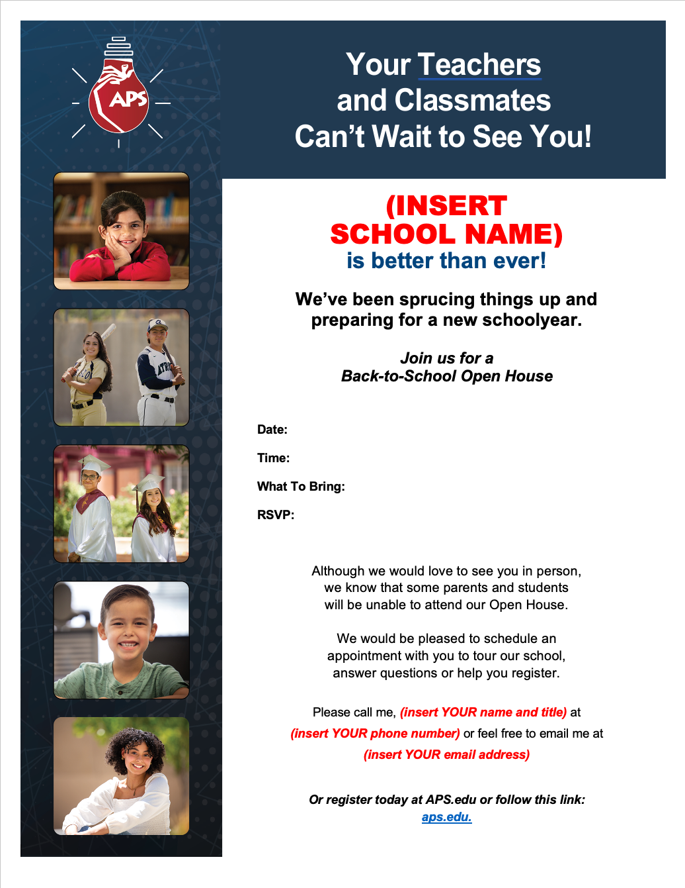
Toolkit Examples
The Toolkit provides a variety of resources and templates that can be customized by principals and school staff.
01 | Open House Checklist
02 | Open House Flyer
03 | Open House Sign-In Sheet
Notes:
Best use of limited resources was to develop a Toolkit that would have resources and templates for a variety of tactics principals can draw from, customized for each school and used at will. Some of the elements include: generic announcements, flyers, templates for conducting events like open houses, school brag sheets, email blast templates, talking points, powerpoint, ONLINE AND DOWNLOADABLE

Slide 15
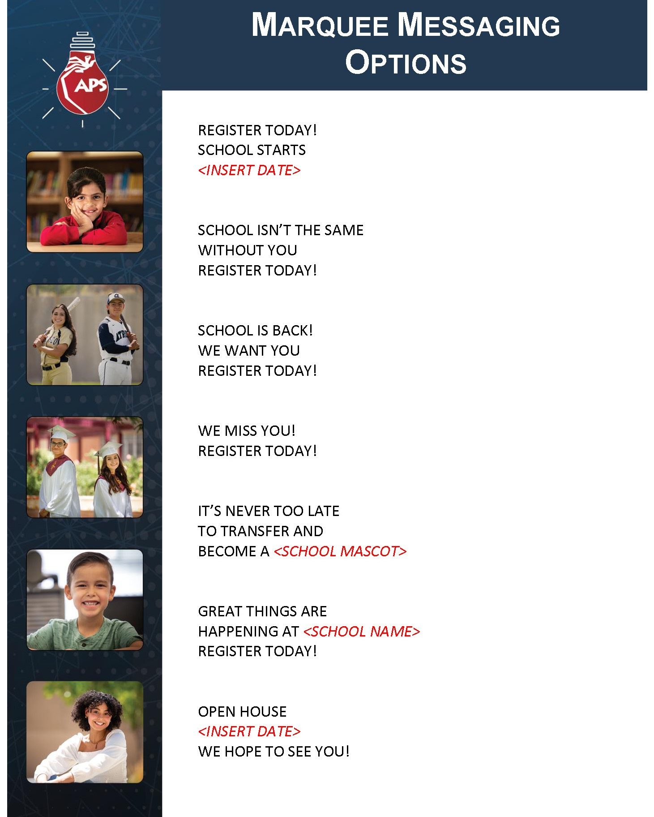
Toolkit Examples
04 | Marquee Messaging
05 | On-Hold Messaging
06 | Direct Mail Template
Notes:
Best use of limited resources was to develop a Toolkit that would have resources and templates for a variety of tactics principals can draw from, customized for each school and used at will. Some of the elements include: generic announcements, flyers, templates for conducting events like open houses, school brag sheets, email blast templates, talking points, powerpoint, ONLINE AND DOWNLOADABLE

Slide 16
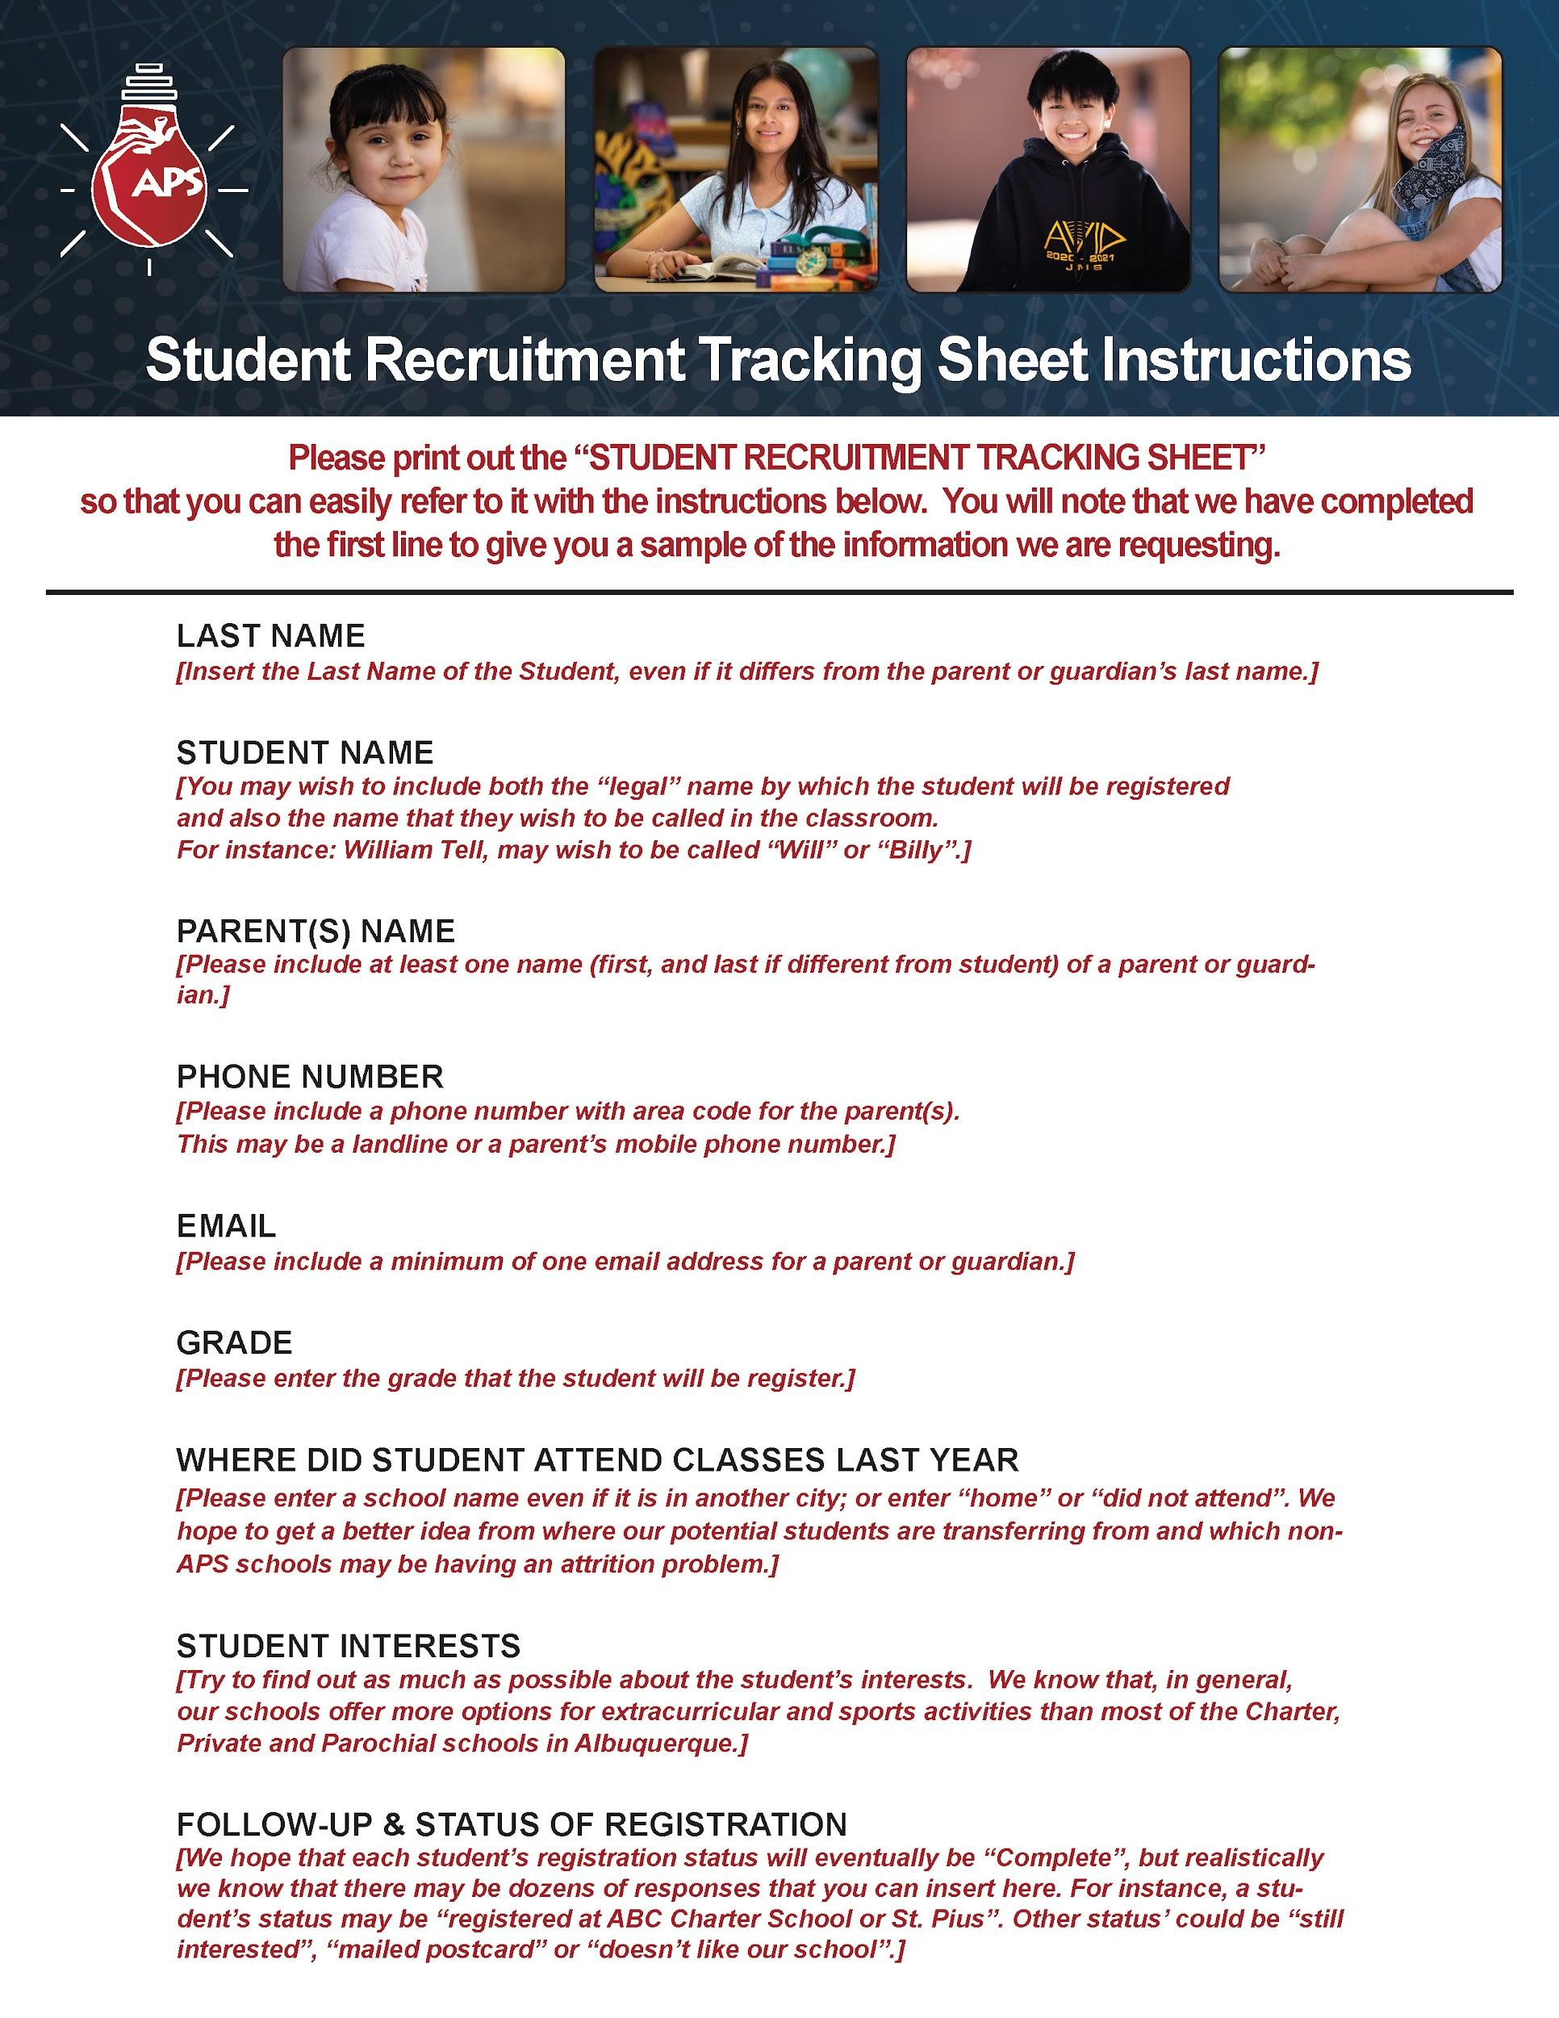
Toolkit Examples
07 | Student Recruitment How-To
08 | Student Recruitment Tracking
Notes:
Best use of limited resources was to develop a Toolkit that would have resources and templates for a variety of tactics principals can draw from, customized for each school and used at will. Some of the elements include: generic announcements, flyers, templates for conducting events like open houses, school brag sheets, email blast templates, talking points, powerpoint, ONLINE AND DOWNLOADABLE

Slide 17
Game Plan
Phase Three
Freelancers to the Rescue
01 | Videographer/Photographer
02 | Writer
03 | Social Media
Notes:
(standard, explanation of process, terms and conditions, scope of work, evaluation criteria, forms & attachments, price proposal, conflict of interest, confidentiality)

Slide 18
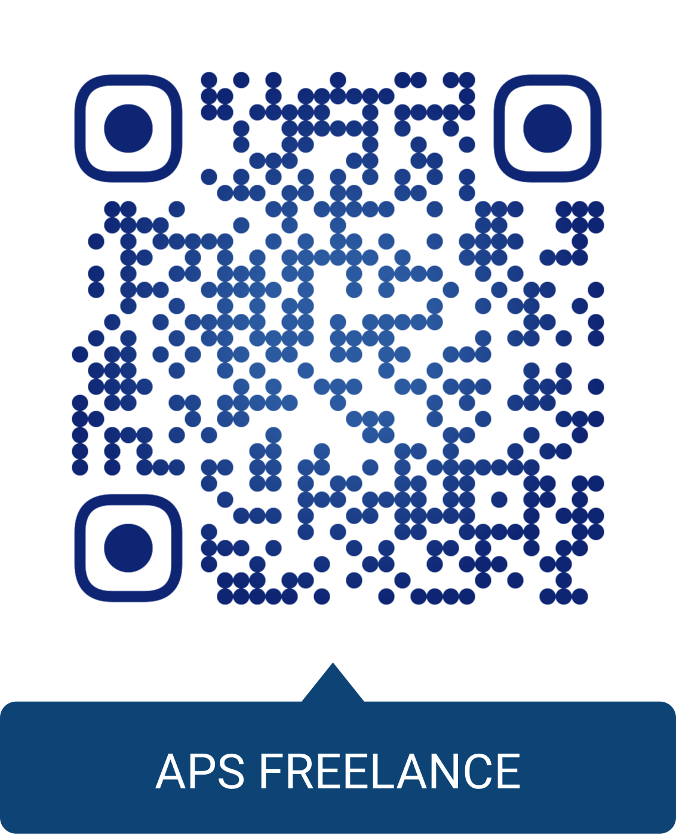
Game Plan
Phase Three
Freelancers Total Cost: $78,000
01 | Pitch the plan
02 | RFP
03 | Personal Service Agreements
04 | Contracts
Notes:
(standard, explanation of process, terms and conditions, scope of work, evaluation criteria, forms & attachments, price proposal, conflict of interest, confidentiality)

Slide 19
Game Plan
Phase Three
Freelancers Report to Duty
01 | In-Person Launch Meeting
02 | Align Team Members for Collaboration
03 | Assign Content Supervisors

Slide 20
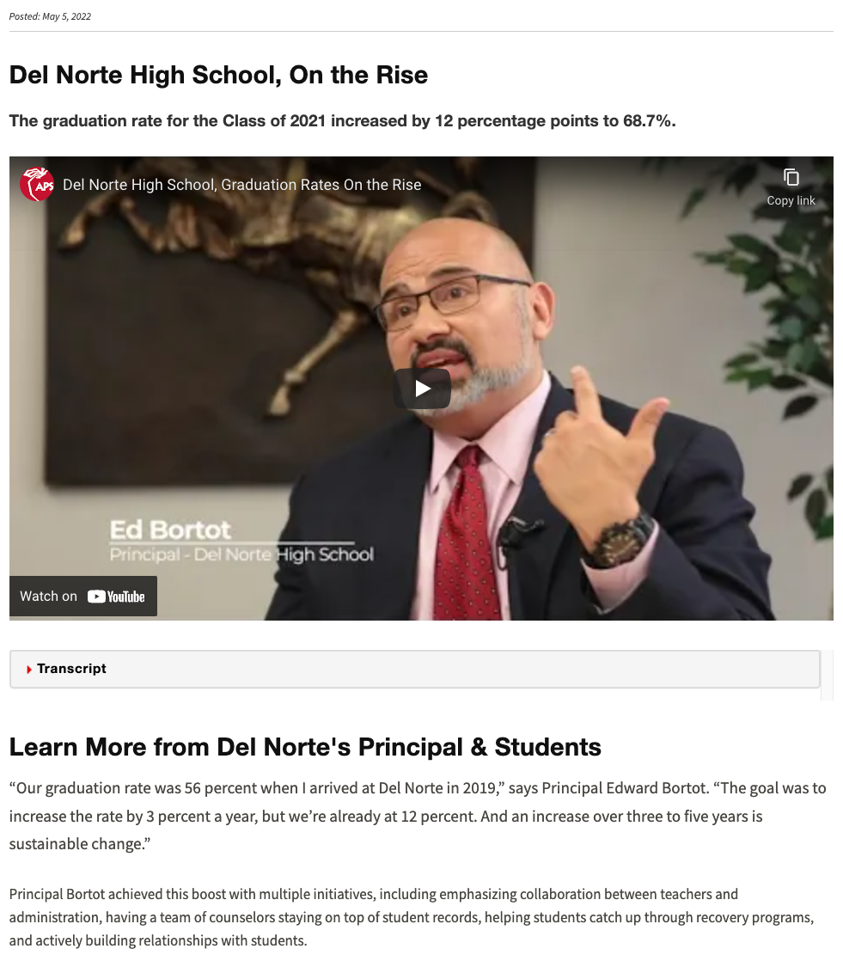
Game Plan
Phase Three
Product Delivery
PRINT

Slide 21
Game Plan
Phase Three
Product Delivery
VIDEO

Slide 22
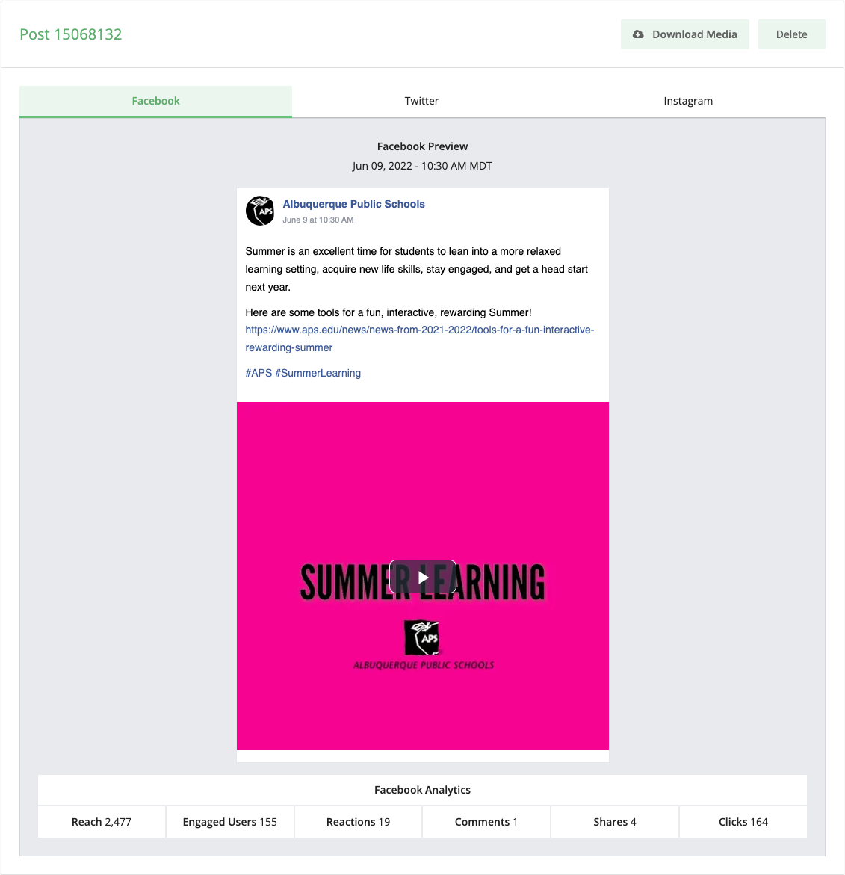
Game Plan
Phase Three
Product Delivery
SOCIAL MEDIA

Slide 23
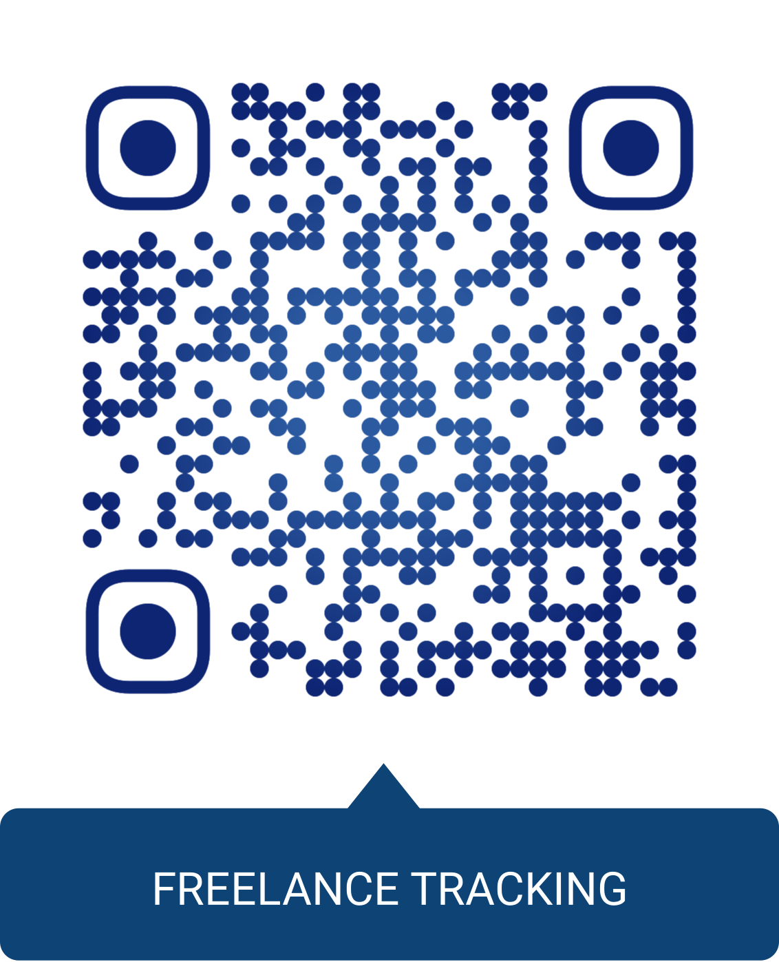
Game Plan
Phase Three
Track Spending

Slide 24
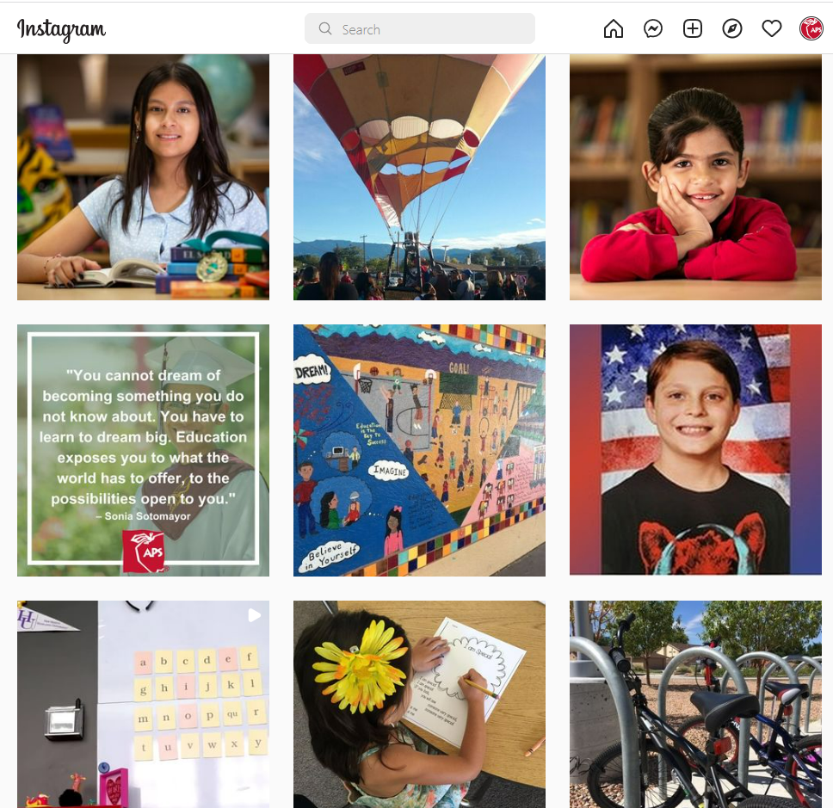
Game Plan
Phase Three
Track Results
SOCIAL MEDIA

Slide 25
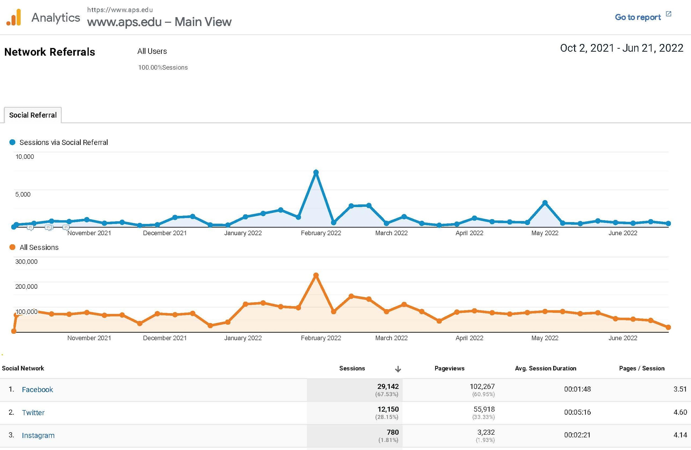
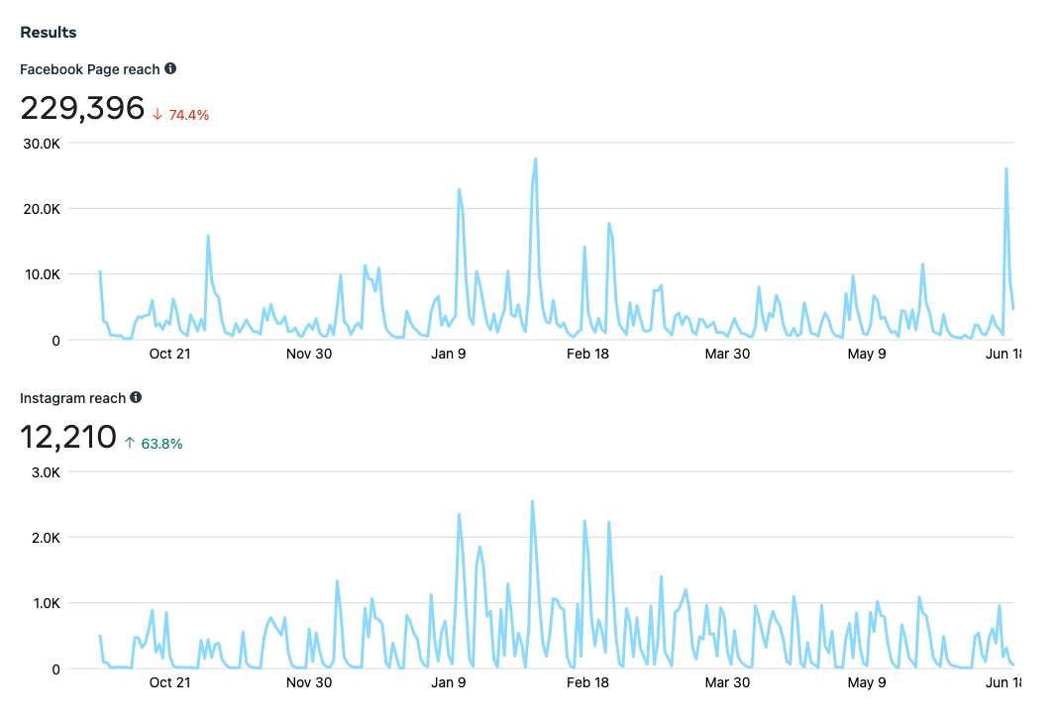
APS Organic Social Media
From 10/1/21 to date, Facebook and Instagram posts have reached 241,606 people, with an avg of 3503 people a day. Facebook, Instagram and Twitter have yielded 42,072 sessions on the APS.edu website, with an average of 4.08 pages were viewed per session.
25,495 new users -- 28,604 users -- 15,315 engaged sessions

Slide 26
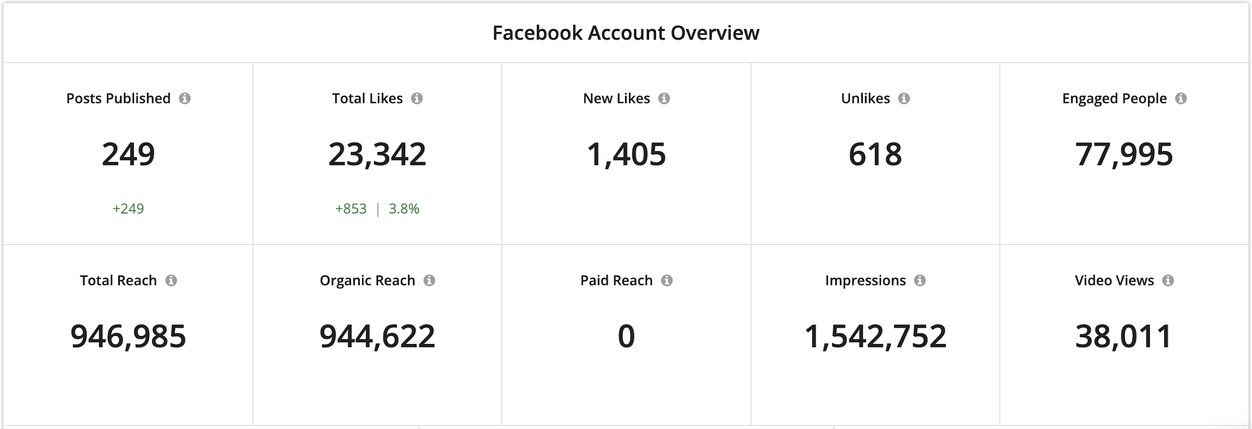
APS Organic Social Media
Advantage APS!
Specific to the freelance efforts in support of APS’s internal team, from October 1, 2021 to date, messaging focused on engagement,
driving traffic to APS.edu, and boosting APS’s position with branded messaging. Efforts have yielded increases in metrics across the board.

Slide 27
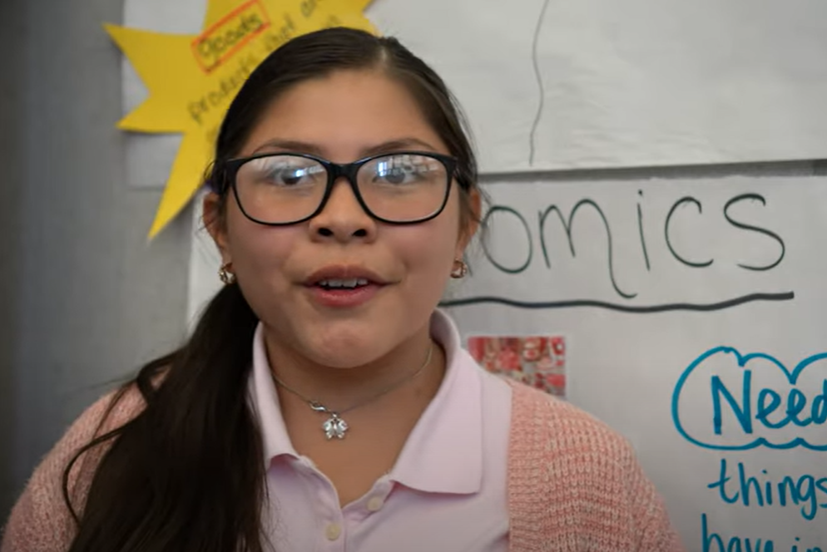
Game Plan
Phase Three
Track Results
VIDEO
25 videos
40 shorts
Cost: $11,000

Slide 28
Comparison
Creative agencies that offer a full range of promotion and advertising services have built-in overhead costs. Freelancers can charge less for their work because their overhead is lower.
Ad Agency
Freelancer
Difference
4 one-minute+ videos
10 shorts
Cost: $6,360
25 one-minute+ videos
40 shorts
Cost: $1,767
$4,592

Slide 29
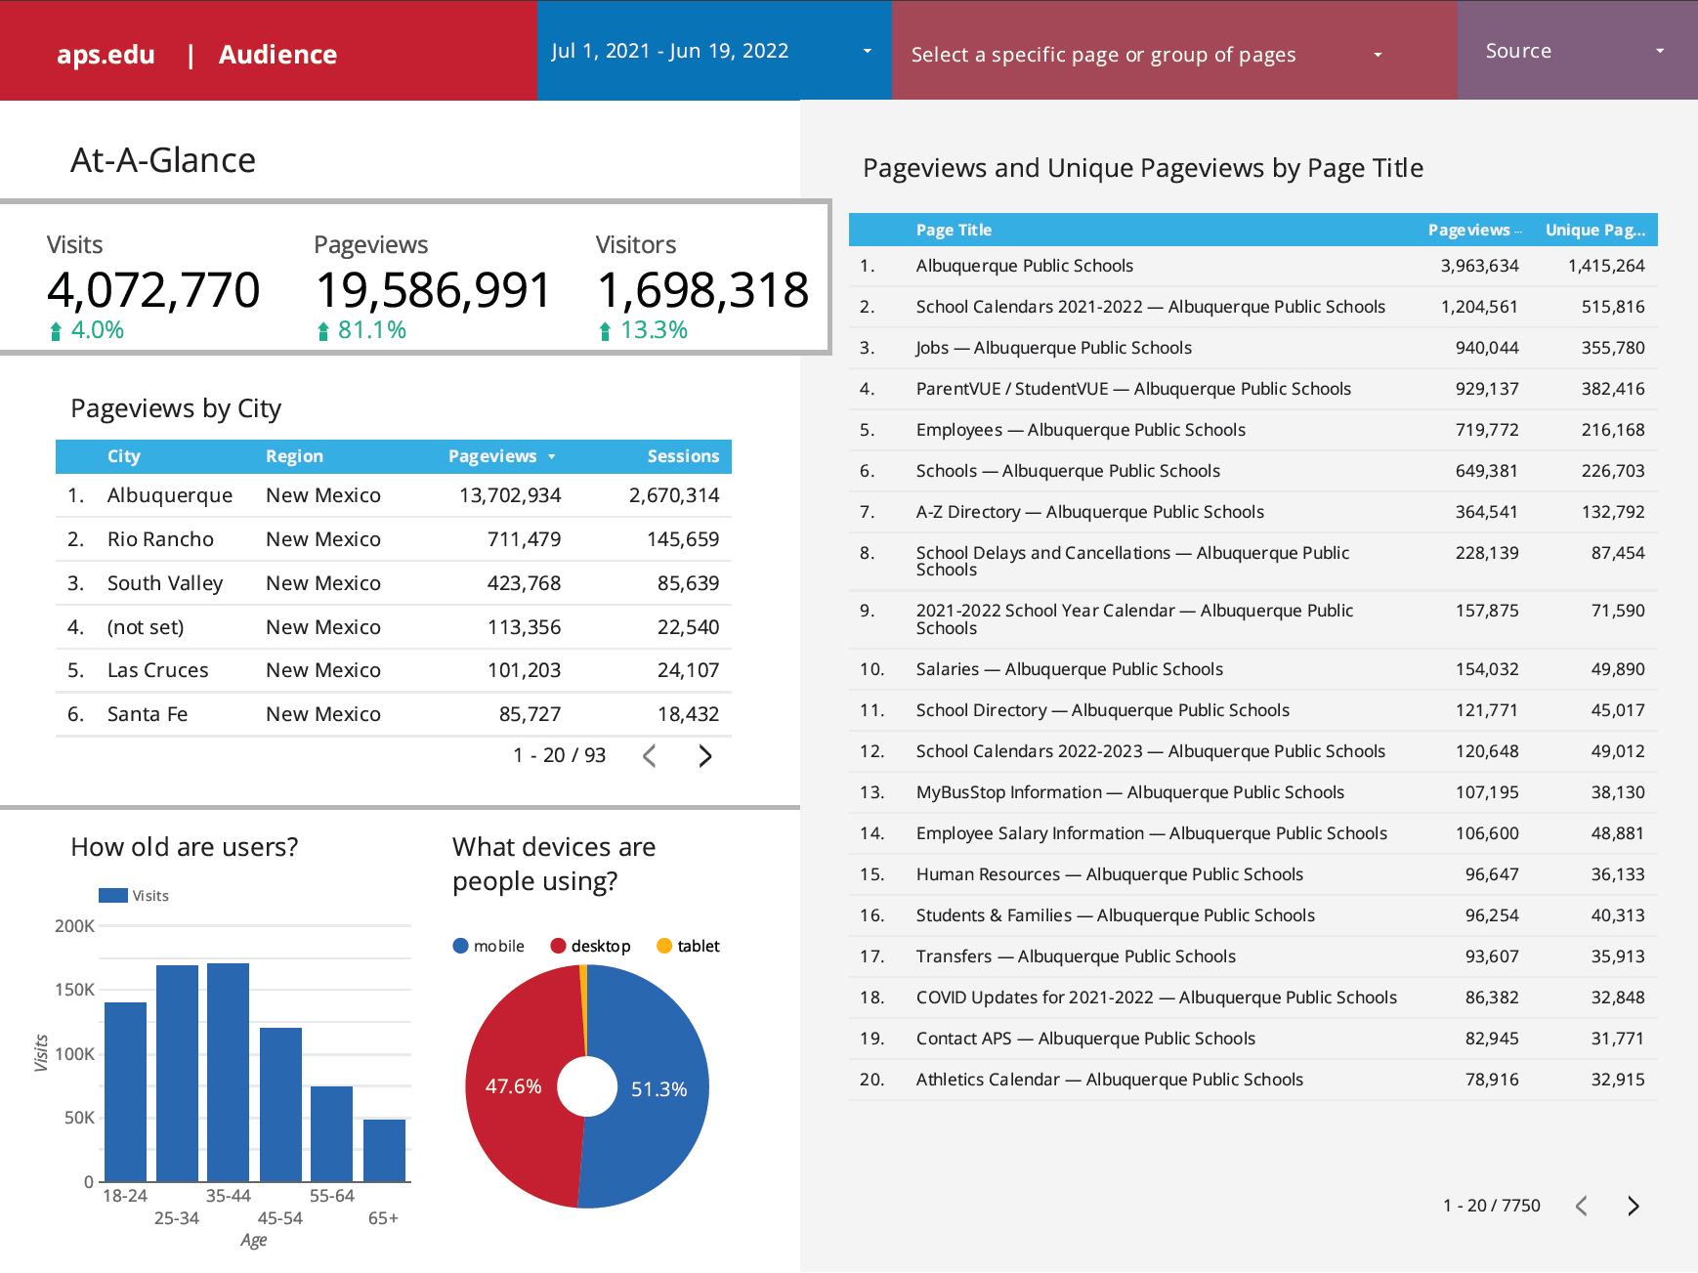
Game Plan
Phase Three
Track Results
WEB

Slide 30
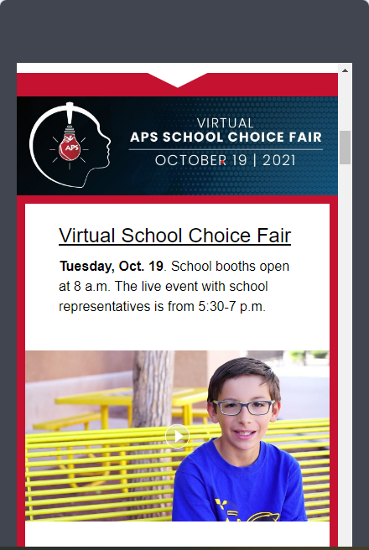
Game Plan
Phase Three
Track Results
Cross Promotion

Slide 31
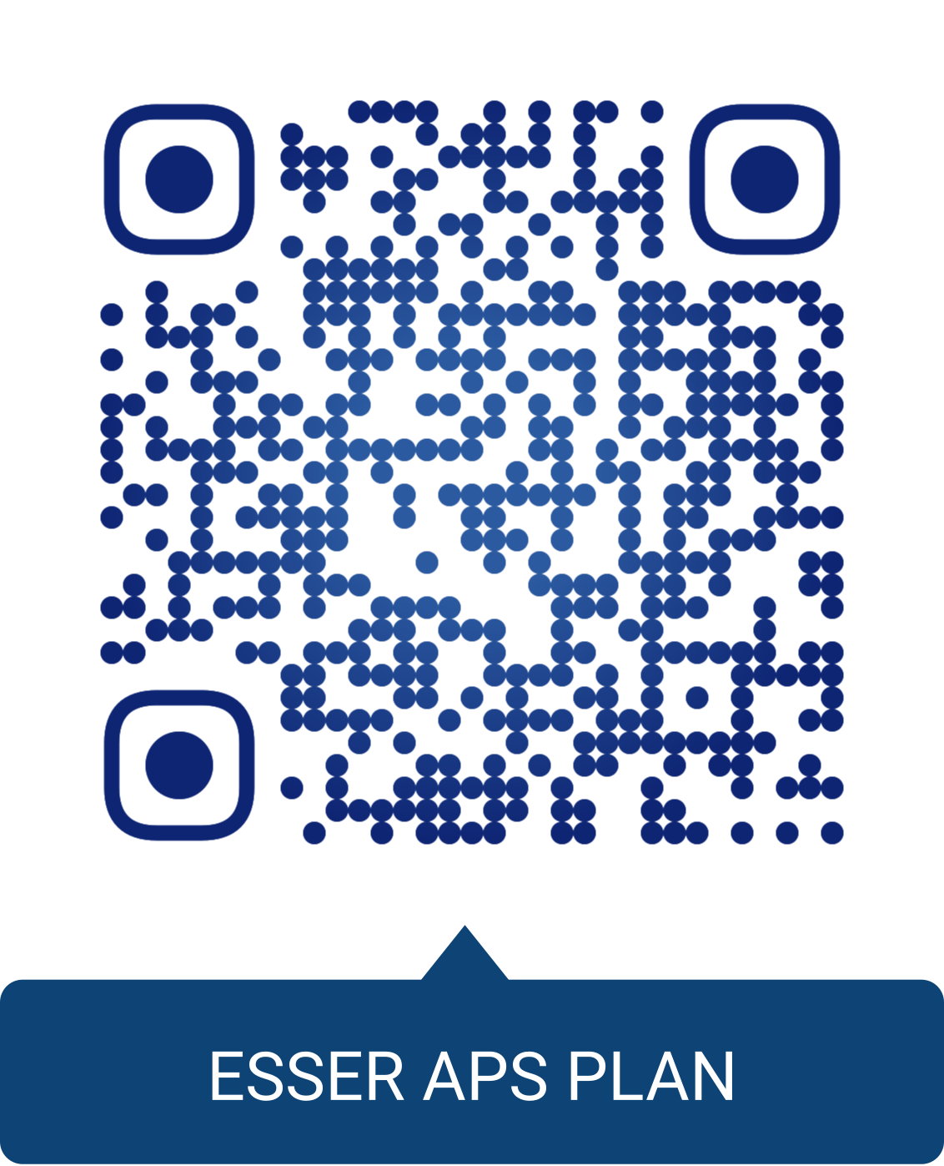
Game Plan
Phase Three
Track Results
ESSER REPORTING

Slide 32
Why It Works
Pre-set contractual fees far below those of marketing agencies
More staff allows for increase in messaging, fresh stories, and greater awareness
No benefits cost to the district
Freelancers are not staff so they offer a fresh viewpoint
Another opportunity to educate the external world about the district
Strengthen school connections
Stronger social engagement
Freelancers have time we don’t so they can:
Put strategies in place for individual marketing
Plan and schedule posts, videos, and print stories
Create more alluring original content

Slide 33
Challenges
Freelancers are not staff so they lack institutional knowledge
APS comms still determines assignments, serves as producer and editor
Limited pool of freelancers to hire
Staff doesn’t always reply to freelancer requests
APS comms doesn’t manage school leadership so we can request assistance but that’s up to individuals
Freelancers may come in with unrealistic expectations about district resources and practices
Freelancers can quit any time
Do not have a process to make paid social media buys
Freelancers can create new content but it’s still up to the district to attract and secure the audience

Slide 34
COMPARE & CONTRAST
Marketing Agency vs. Freelancers…
not even close

Slide 35
Realistic Goal Setting
Boost the steady stream of compelling, timely, factual, and meaningful stories about Albuquerque Public Schools that are easy to consume and hard to forget.
Compete with private and charter school marketing to attract and retain students & families
Drive our own narrative
EDITORIAL
APS’ Latest Budget a $2 Billion Question
Are consolidations of the district’s 143 schools inevitable? The budget doesn’t address that. And where did those 5,500 students from last year go and what is APS doing to try bring them back or right-size? Ditto.
APS, with 15,000 employees and 71,460 students, has a sophisticated website, an extensive email list, large social media presence and foundation. It could use its large platform to better inform the public about how it is addressing enrollment declines and spending.

Slide 36
What Next?
You don’t know if you don’t ask
Request additional federal funds to extend freelance contracts
Continue to use analytics to determine greatest impact of freelance contributions
Seek process to make paid social media buys
Develop data-driven communication and marketing plans
Address new school board’s expressed desire for improved communications and marketing

Slide 37
Questions & Answers
THANK YOU

